Slide 1
Cleaning and Disinfecting the Environment
Nursing
Notes:
Let’s do a brief review of the important factors related to cleaning and disinfecting the environment .
It is important to remember that everyone on staff is responsible for maintaining a safe, clean environment for the protection of everyone in the facility.
While the EVS staff is primarily responsible for the cleaning of the environment, nursing is expected to clean surfaces that become soiled or contaminated using the appropriate products.

Slide 2
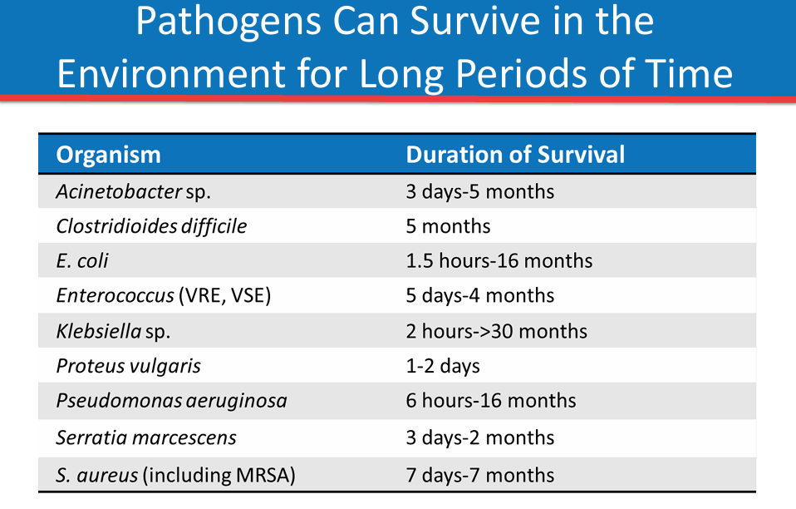
Notes:
Pathogens contaminate environmental surfaces, fixtures, and furniture, and they can survive for very long periods of time in the absence of effective cleaning and disinfection processes.
Most of us have probably heard that C. diff spores can survive in the environment for months, but it is less commonly known how long many other pathogens can survive in the environment.
As shown in this table, many of these pathogens, including MRSA and gram-negative organisms such as Acinetobacter and Pseudomonas, are capable of surviving for hours to days to weeks, and even for several months.
This ability to persist in the environment can play a critical role in the transmission of pathogens from resident-to-resident.

Slide 3

Categories of Disinfectants and Disinfection Process
Low level disinfection kills most vegetative bacteria, some viruses, and some fungi, but cannot be relied upon to kill mycobacteria or bacterial spores.
1
Intermediate level disinfection kills vegetative bacteria, most viruses and most fungi, but does not reliably kill all bacterial spores.
2
They do kill C. diff spores
High level disinfection is a specialized skill performed in certain areas of the facility
3
Notes:
It is important to understand that even within the category of disinfection, there are three subcategories, or levels of disinfection, to be familiar with.
Low level disinfection kills most vegetative bacteria, some viruses, and some fungi, but cannot be relied upon to kill mycobacteria or bacterial spores.
Intermediate level disinfection kills vegetative bacteria, most viruses and most fungi, but does not reliably kill bacterial spores.
High level disinfection, often referred to as HLD, is a specialized skill performed in certain areas of the facility

Slide 4
Surface Cleaning Schedule
Perform routine and targeted cleaning of environmental surfaces as indicated by the level of resident contact and degree of soiling.
Clean and disinfect surfaces in close proximity to the resident and frequently touched surfaces in the resident care environment on a more frequent schedule compared to other surfaces.
All staff should promptly clean and decontaminate spills of blood or other potentially infectious materials OR contact environmental services for immediate assistance.
Reusable medical equipment will be described in a different section of training.

Slide 5
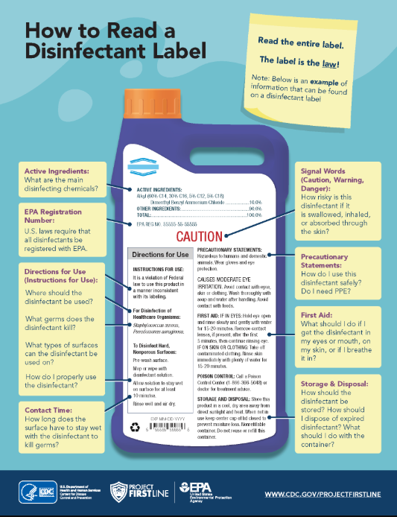
Notes:
The facility has several different types of disinfectants, and it is vital for nurses to know which product to use on the different surfaces and how to properly use them.
Instructor: Give an example of resident care environment and what disinfectant to use.
Manufacturers are required by OSHA to properly label disinfectants.
Instructors: review the information on the slide:
Directions for use-including microorganisms the disinfectant will kill
Contact Time
Signal word-caution statements
Precautionary statement – what PPE to wear when using the product
First aid
Storage and Disposal
Chemicals must be securely stored when not in use.
All cleaning supplies should be stored in their original container, and any other containers should be properly labeled.

Slide 6
Disinfectants
Select EPA-registered disinfectants that have microbiocidal activity against the pathogens most likely to contaminate the resident-care environment.
When information from manufacturers is limited regarding selection and use of agents for specific microorganisms, environmental surfaces or equipment, facility policies regarding cleaning and disinfecting should be guided by the best available evidence and careful consideration of the risks and benefits of the available options.

Slide 7
Resources
CDC's Core Infection Prevention and Control Practices for Safe Healthcare Delivery in All Settings, CDC's Core Infection Prevention and Control Practices for Safe Healthcare Delivery in All Settings | Infection Control | CDC, Accessed 08-19-2025
CDC Environmental Cleaning and Disinfection: Principles of Infection Transmission and the Role of the Environment, https://www.cdc.gov/infection-control/media/pdfs/Strive-EC101-508.pdf Accessed 06-25-2025
CDC Cleaning and Disinfection Strategies for Non-Critical Surfaces and Equipment, https://www.cdc.gov/infection-control/media/pdfs/Strive-EC102-508.pdf Accessed 06-25-2025
EPA How to Read A Disinfectant Label, https://www.epa.gov/system/files/images/2022-09/HowToReadALabel-508c-Final-2022-08-30%20%28005%29_1.png Accessed 06-25-2025

